Slide 1
Exam Marks Upload Convertor - User Guide

Slide 2
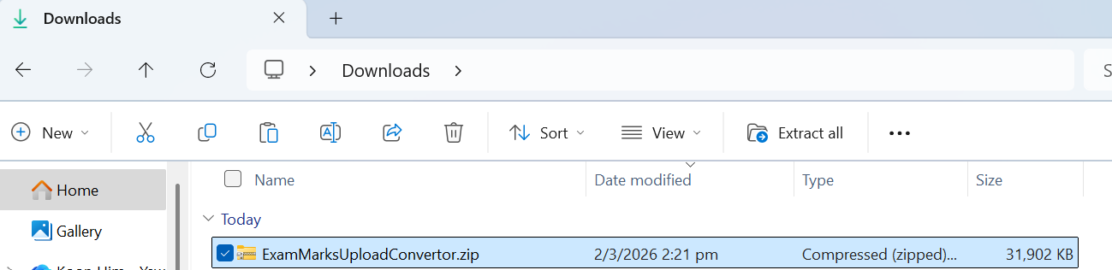
Step 1: Open the Folder
Select the “ExamMarksUploadConvertor.zip”
Click “Extract all”
(2)
(1)

Slide 3
Step 1: Open the Folder
Select the “ExamMarksUploadConvertor.zip”
Click “Extract all”
(2)
(1)

Slide 4
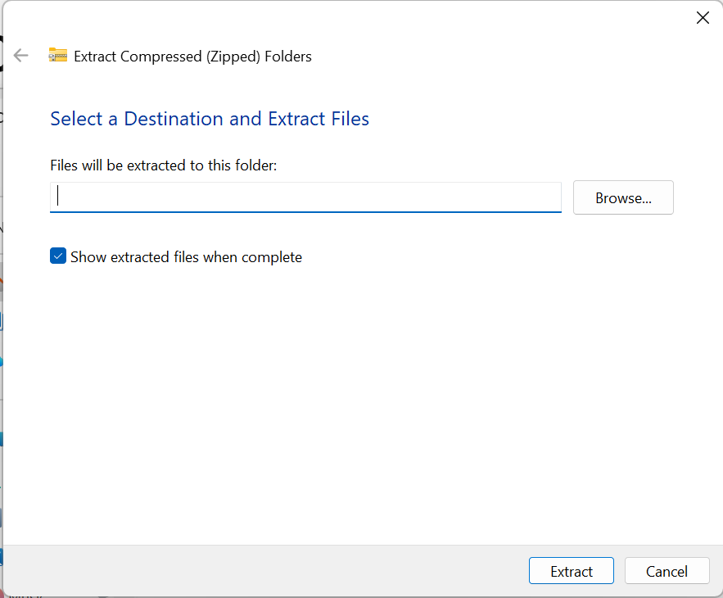
Step 1: Open the Folder
Browse a position to extract the zip file
Click “Extract”
(3)
(4)

Slide 5
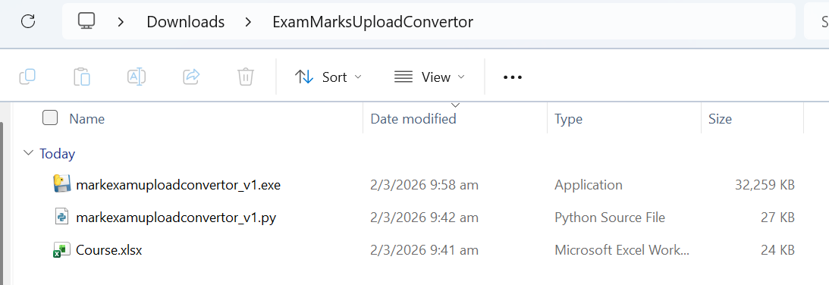
Step 2: Run the program
Double click “markexamuploadconvertor_v1.exe” to run the program
* “Course.xlsx” is used to upload to the Step 2 (3) later

Slide 6
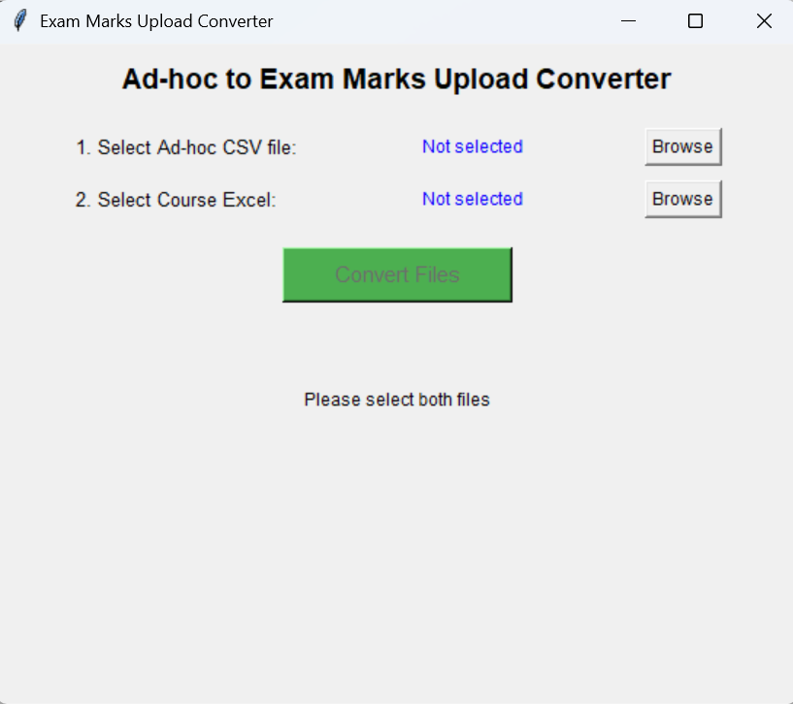
Step 2: Run the program
(2)
Browse the upload CSV file
Browse the provided Course Excel file “Course.xlsx”
Click “Covert Files”
(3)
(4)

Slide 7
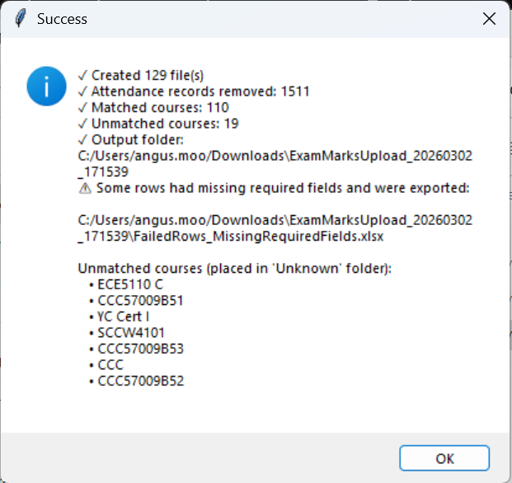
Step 2: Run the program
Wait the “Success” windows, find the export file in the File Explorer according this path
For any rows have empty field in the CSV file, will export to this file
Press ok

Slide 8
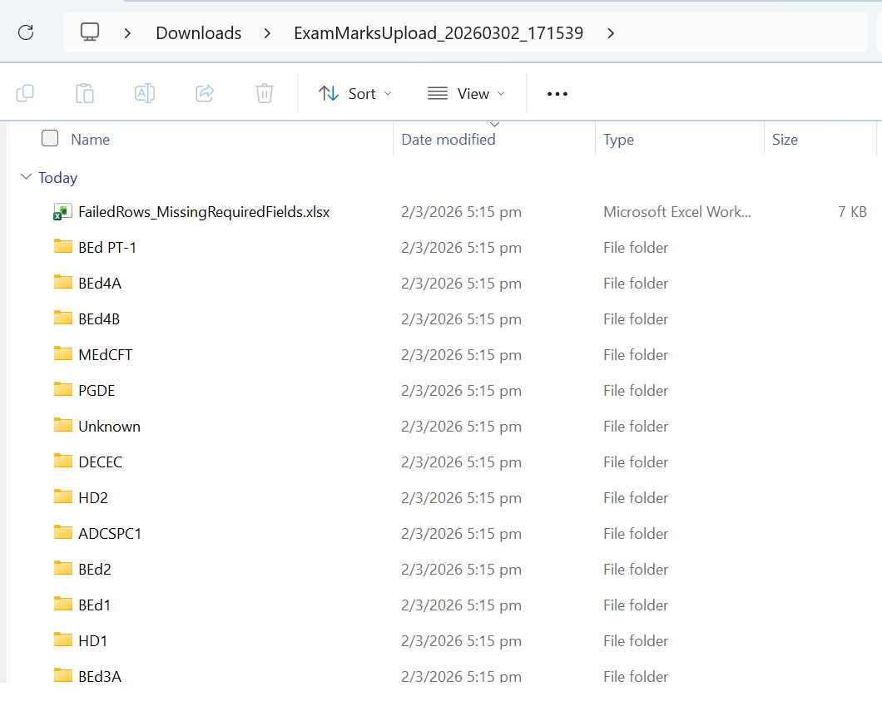
Step 2: Run the program
Open the Folder, here is the result
Name of the folder is “ExamMarksUpload_(Date)_(Time)”
Data not matched course short name in the “Course.xlsx” will put in “Unkown” folder

Slide 9
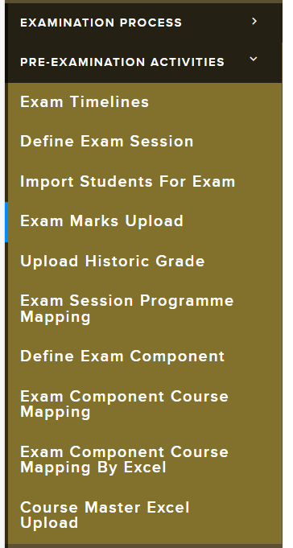
Step 3: Upload to SIS
Login to SIS
Click “PRE-EXAMINATION ACTIVITIES”
Click “Exam Marks Upload”

Slide 10
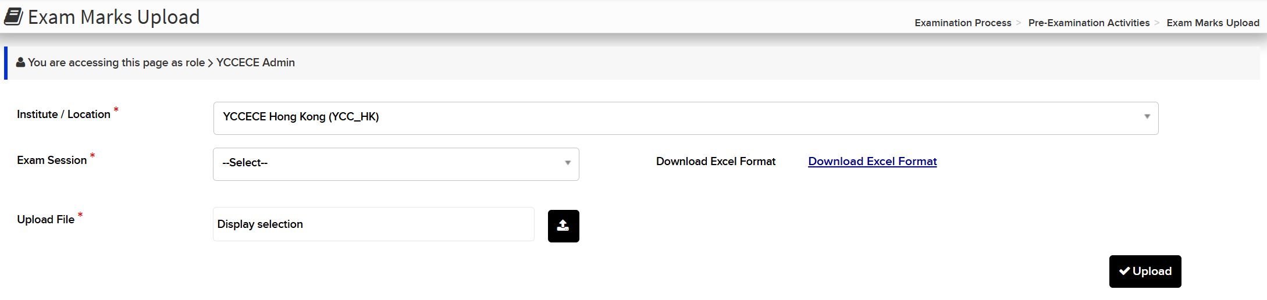
Step 3: Upload to SIS
(4)
(6)
(5)
Select the Exam Session to upload
Select one Excel file from the exported folders in step 2 (7)
Press “Upload”

Slide 11
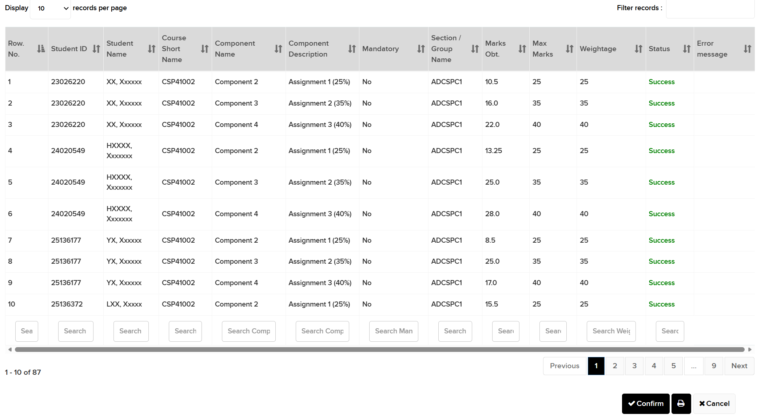
Step 3: Upload to SIS
(7)
Check any error message need to fix, if no, press “Confirm”

Slide 12
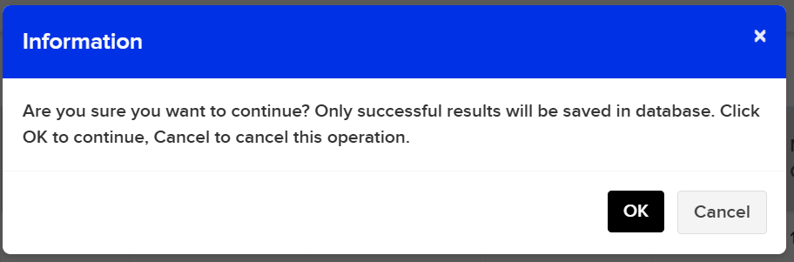
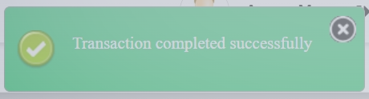
Step 3: Upload to SIS
Click “OK”
Successful message appear
(8)

